Slide 1

MODY UNIVERSITY OF SCIENCE AND TECHNOLOGY
Colloquium Presentation
CS 14.371
Submitted by-
Akshita Kanther
B.Tech. IIIrd yr C2
Er.No.-180161
Submitted to-
Dr. Pervesh Kumar Bishnoi
Ms. Sonal Shukla

Slide 2

DATA PREPARATION WITH PANDAS

Slide 3

Contents
Introduction
Why Should We Prepare Our Data
Python
Python Libraries
Pandas
Features of Pandas
Core Components Of Pandas
Pandas Operations
Typical Pipeline For Data Preparation
Common Tasks Involved In Data Preparation
Applications Of Pandas
Companies using Pandas
Summary

Slide 4
Introduction
Data preparation is the first step after you get your hands on any kind of dataset. This is the step when you pre-process raw data into a form that can be easily and accurately analyzed. Proper data preparation allows for efficient analysis - it can eliminate errors and inaccuracies that could have occurred during the data gathering process and can thus help in removing some bias resulting from poor data quality. Therefore a lot of an analyst's time is spent on this vital step.

Slide 5

Why should WE prepare OUR data

Slide 6

Garbage in, garbage out
Reduce errors
Remove duplicate records
Fix missing values
Correct range values
Fix formatting (i.e. date, text, number)

Slide 7

python
Object-oriented, high-level programming language
Used as a scripting language to connect existing components together
Simple, easy to learn syntax emphasizes readability
Supports modules and packages

Slide 8

python Libraries
Many popular Python toolboxes/libraries:-
NumPy
SciPy
Pandas
SciKit-Learn
Visualization libraries:-
matplotlib
Seaborn

Slide 9


Slide 10

pandas
Pandas is a software library written for Python
Pandas has so many uses that it might make sense to list the things it can't do instead of what it can do
This tool is essentially your data’s home. Through pandas, you get acquainted with your data by cleaning, transforming, and analyzing it
Pandas is well suited for different kinds of data, such as:
Tabular data with heterogeneously-typed columns
Ordered and unordered time series data
Arbitrary matrix data with row & column labels
Unlabelled data
Any other form of observational or statistical data sets
To use the pandas library, you need to first import it. Just type this in your python console:

Slide 11
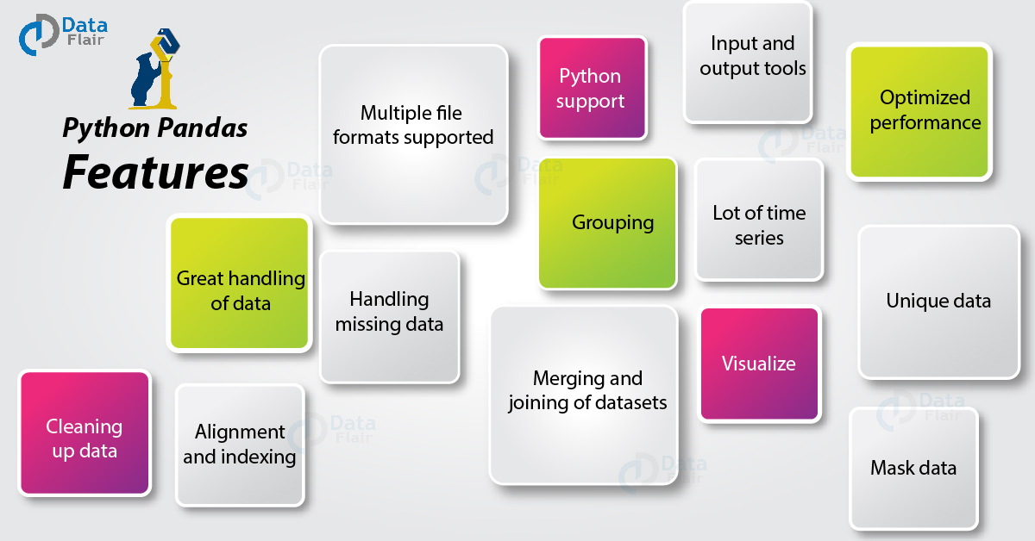

Slide 12
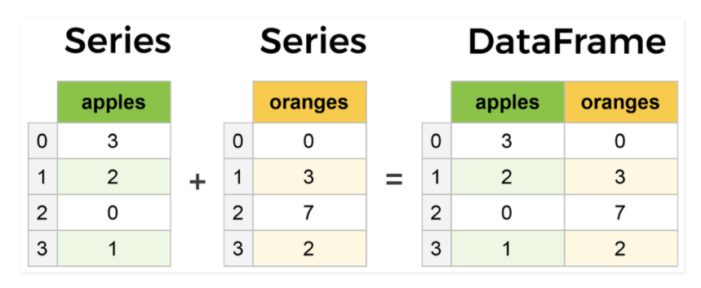
CORE components of pandas
The primary two components of Pandas are:-
Dataframe
Series
A Series is essentially column and a Dataframe is a multidimensional Table made up of a collection of Series.

Slide 13
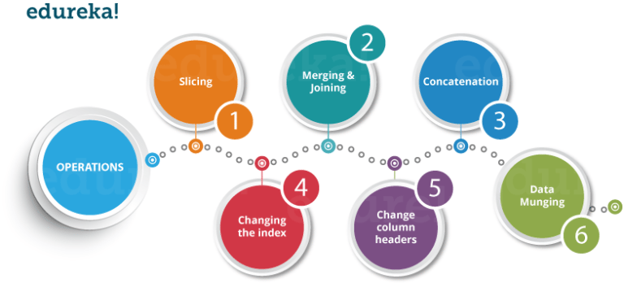
Pandas operations
Using Python pandas, you can perform a lot of operations with series, data frames, missing data, group by etc. Some of the common operations for data manipulation are listed below:

Slide 14
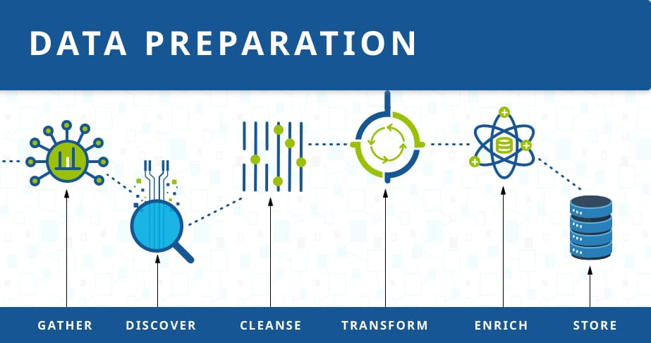
Typical pipeline for data preparation

Slide 15
The first step of a data preparation pipeline is to gather data from various sources and locations
Before any processing is done, we wish to discover what the data is about. At this stage, we understand the data within the context of business goals and Visualization of the data is also helpful here
The next stage is to cleanse the data of missing values and invalid values. We also reformat data to standard forms
Next we transform the data for a specific outcome or audience
We can enrich data by merging different datasets to enable richer insights
Finally, we store the data or directly send it out for analytics

Slide 16
Common Tasks involved in Data preparation
Data preparation involves one or more of the following tasks:
Aggregation: Multiple columns are reduced to fewer columns. Records are summarized
Anonymization: Sensitive values are removed for the sake of privacy
Augmentation: Expand the dataset size without collecting more data. For example, image data is augmented via cropping or rotating
Blending: Combine and link related data from various sources. For example, combine an employee's HR data with payroll data
Decomposing: Decompose a data column that has sub-fields. For example, "6 ounces butter" is decomposed into three columns representing value, unit and ingredient
Deletion: Duplicates and outliers are removed. Exploratory Data Analysis (EDA) may be used to identify outliers
Tasks involved in Data Preparation
Aggregation
Augmentation
Decomposing
Deletion
Blending
Anonymization

Slide 17
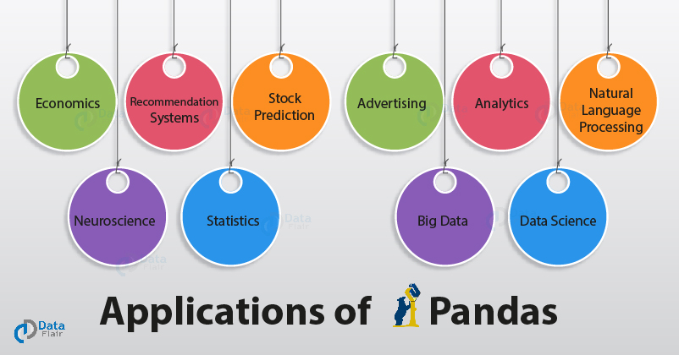
Applications of pandas

Slide 18






Companies using pandas

Slide 19
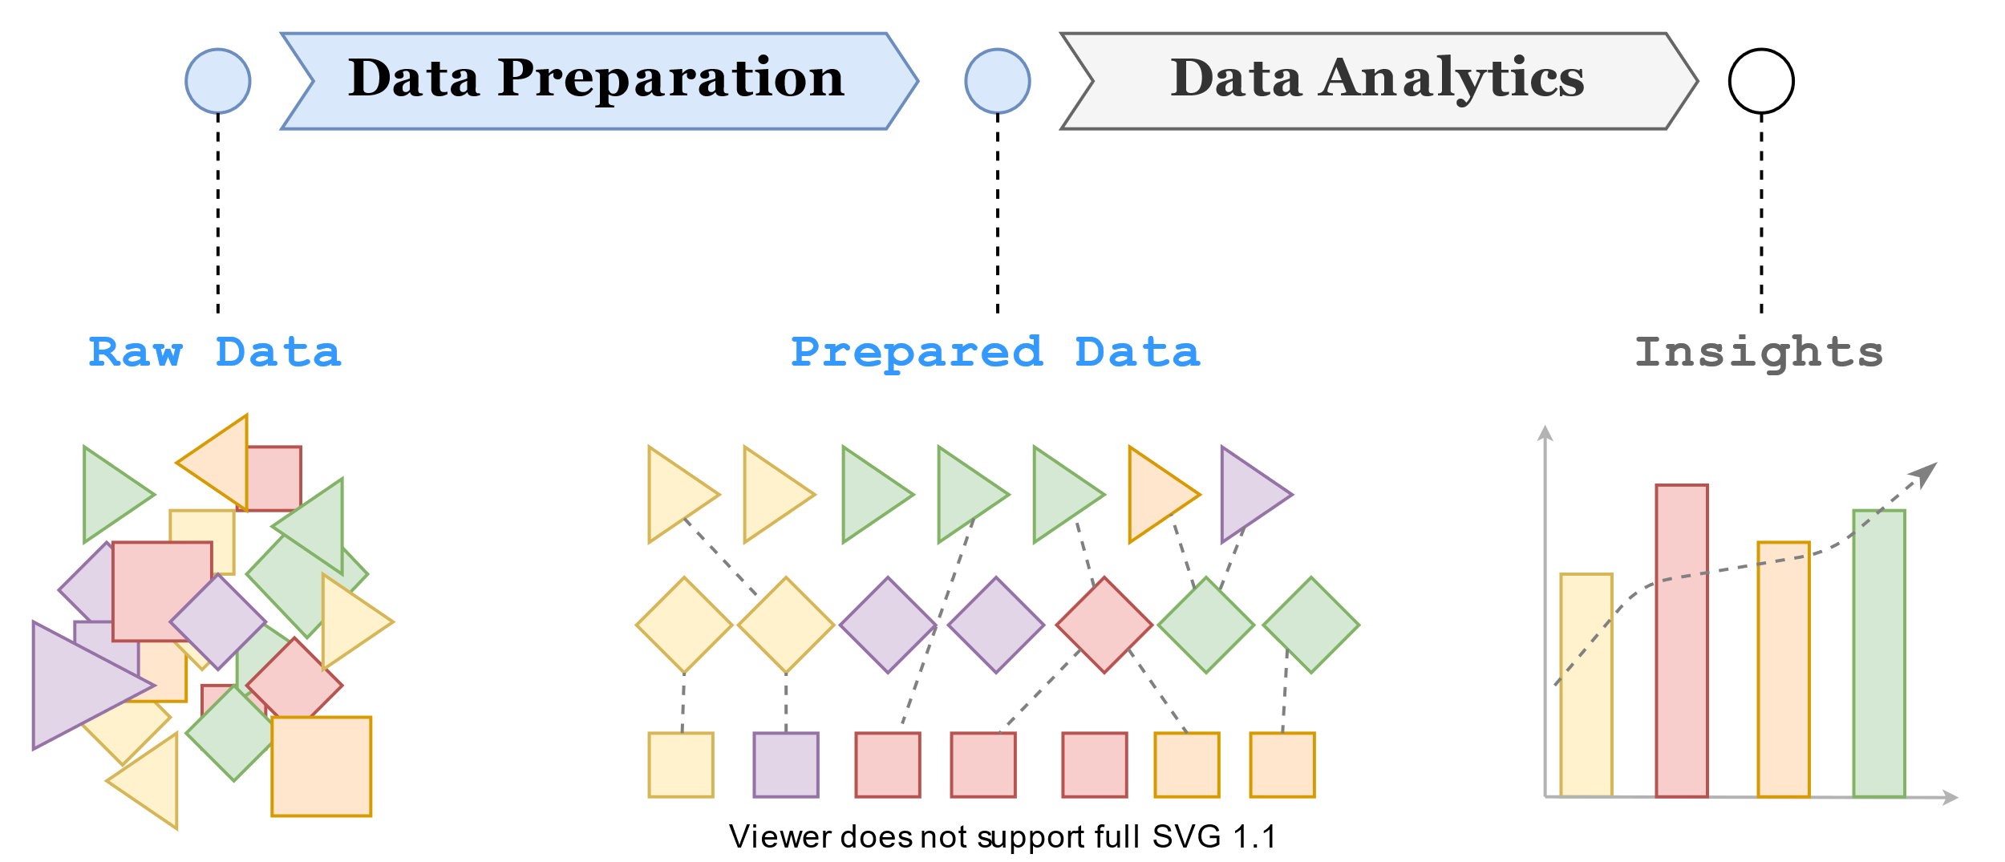
Summary
Raw data is usually not suitable for direct analysis. This is because the data might come from different sources in different formats. Moreover, real-world data is not clean. Some data points might be missing. Some others might be out of range. There could be duplicates. Data preparation is therefore an essential task that transforms or prepares data into a form that's suitable for analysis.
Data preparation assumes that data has already been collected. However, others may consider data collection and data ingestion as part of data preparation. Within data preparation, it's common to identify sub-stages that might include data pre-processing, data wrangling, and data transformation.

Slide 20
THANK YOU

Slide 21


